Slide 1
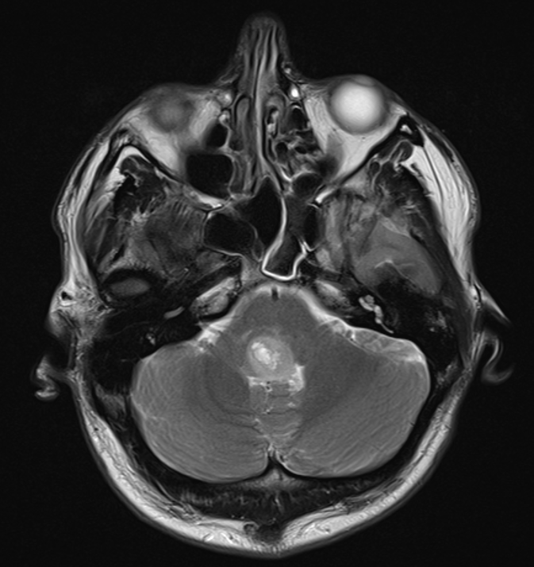
A
Right VII
Pons
Lesion
4th ventricle
Cerebellar hemisphere
Right
Left

Slide 2
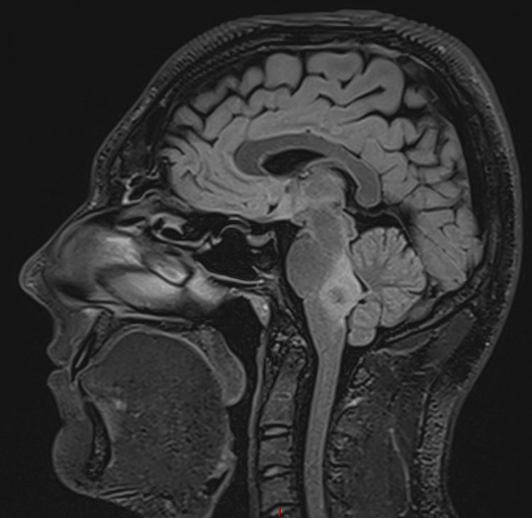
B
Body of corpus callosum
Lateral ventricle
Genu
Splenium
Superior cerebellar cistern
Midbrain
Cerebellum
Pons
4th ventricle
Lesion
Medulla
Cerebellar tonsil
Cervical spinal cord
Anterior
Posterior

Slide 3
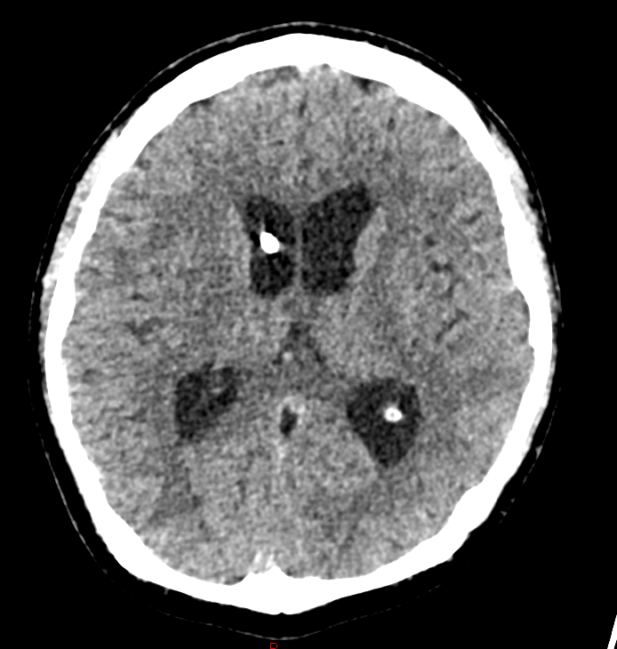
C
Frontal horn of lateral ventricle
Septum pellucidum
Ventricular access device
Third ventricle
Posterior horn of lateral ventricle
Choroid plexus
Right
Left

Slide 4
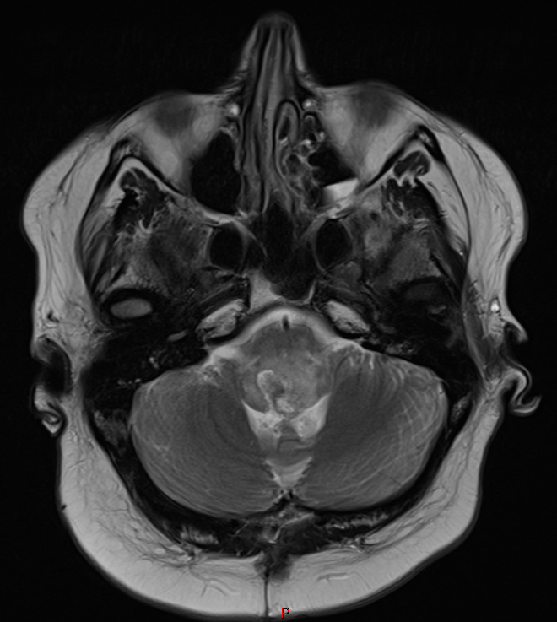
D
Pons
Lesion
Cerebellar hemisphere
Right
Left
Notes:
Final scan 29.1.24 progressive mass, effacement, cushingoid

